Slide 1
Higgs Boson Identification
Pattern recognition / pattern recognition techniques
Beytula Redzheb Ibrahim abtula Kyazim Kyazimov
Master in informatics engineering 2014 / 2015

Slide 2
The Project
The Higgs boson is an elementary particle postulated in the 1970 by 6 scientists, including Peter Higgs;
They described that some fundamental particles have mass and stayed together because of a field, created by the so called Higgs boson;
Between 2012 and 2013 a particle with some properties of the Higgs boson was measured on behalf of the Atlas project at the CERN Large Hadron Collider;
The Higgs boson become measurable by colliding two protons that traveled in opposite directions at approximately the speed-of-light.
Beytula | Ibrahim | Kyazim 2014 / 2015

Slide 3
Objectives
Adopt a Pattern Recognition / Machine Learning approach to classify collision event into ‘tau tau decay of a Higgs boson’ versus ‘background’;
Beytula | Ibrahim | Kyazim 2014 / 2015

Slide 4
Dataset Description
250 000 events (200 000)
An event ID column
30 features columns
A label column
All features are floating point, except PRI_jet_num which is integer
Features prefixed with PRI (for PRImitives) are “raw” quantities
Features prefixed with DER (for DERived) are quantities computed from the primitive features
Beytula | Ibrahim | Kyazim 2014 / 2015

Slide 5
Data Preprocessing
Sorting by event ID, in ascending order;
Substitution of missing values (-999) with NaN
Missing values imputation
Normalization
Feature Selection
Reduction
Beytula | Ibrahim | Kyazim 2014 / 2015

Slide 6
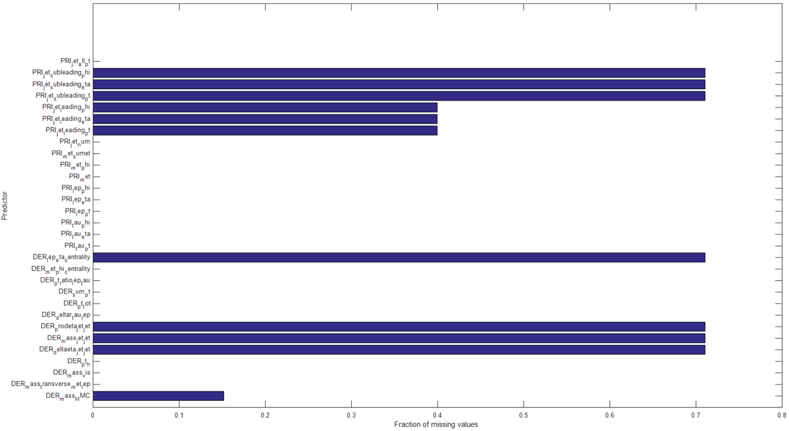
Fraction of Missing Values
Beytula | Ibrahim | Kyazim 2014 / 2015

Slide 7
Methods for dealing with missing values
Nearest-neighbor method – knnimpute()
Principal components using the alternating least squares (PCA ALS) algorithm
inpaint_nans()
Beytula | Ibrahim | Kyazim 2014 / 2015

Slide 8
Normalization
Scaled in order to have zero mean and unitary standard deviation
Beytula | Ibrahim | Kyazim 2014 / 2015

Slide 9
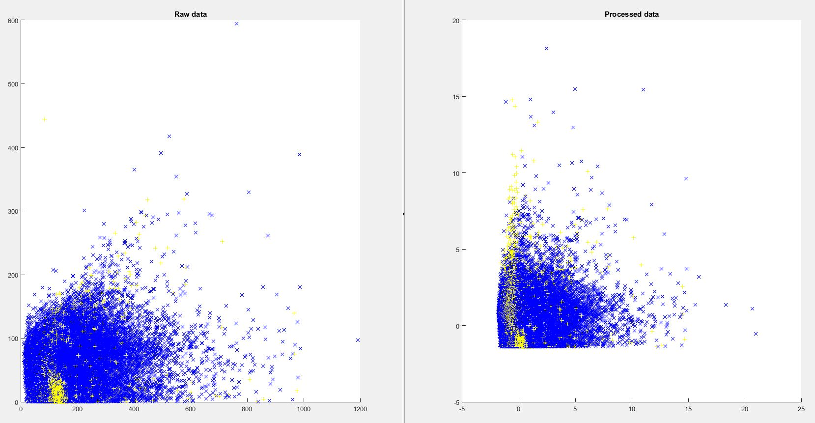
Dataset before and after imputation
Beytula | Ibrahim | Kyazim 2014 / 2015

Slide 10
Cross-validation error
obj = fitcdiscr(data, y); cvm = crossval(obj); L = kfoldLoss(cvm) => 0.2532
classf = @(XTRAIN, ytrain, XTEST)(classify(XTEST,XTRAIN,ytrain)); cvMCR = crossval('mcr', data, y, 'predfun', classf) => 0.2646
ada = fitensemble(data, y, ‘AdaBoostM1’, 500, ‘MinLeafSize’, 5, ‘LearnRate’, 0.1); cv = crossval(ada, ‘KFold’, 5); kfoldLoss(cv, ‘Mode’ ‘Cumulative’) => 0.1625
Beytula | Ibrahim | Kyazim 2014 / 2015

Slide 11
Feature selection
Received operating characteristic (ROC) analysis
Kruskal-Wallis test;
Importance of predictors using ReliefF algorithm;
Sequential Feature Selection (SFS)
Direction: forward and backward;
Type of discriminant function: linear, mahalanobis, diagonal linear, quadratic and diagonal quadratic;
Beytula | Ibrahim | Kyazim 2014 / 2015

Slide 12
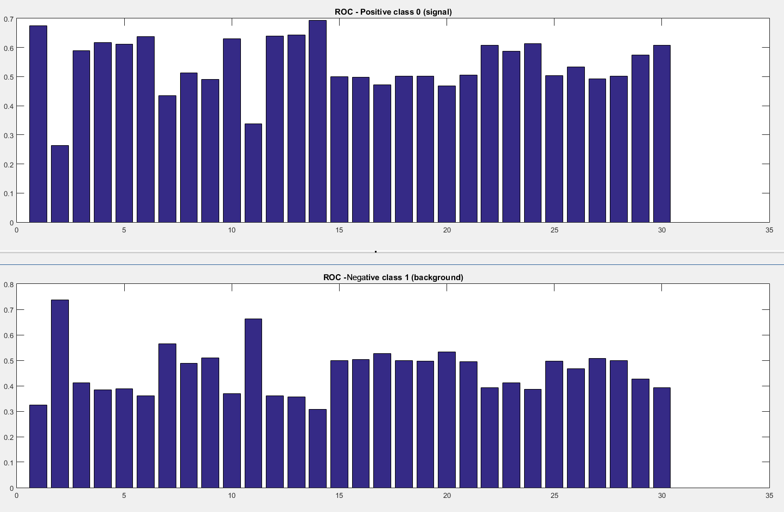
ROC – area under the curve (AUC
Beytula | Ibrahim | Kyazim 2014 / 2015

Slide 13
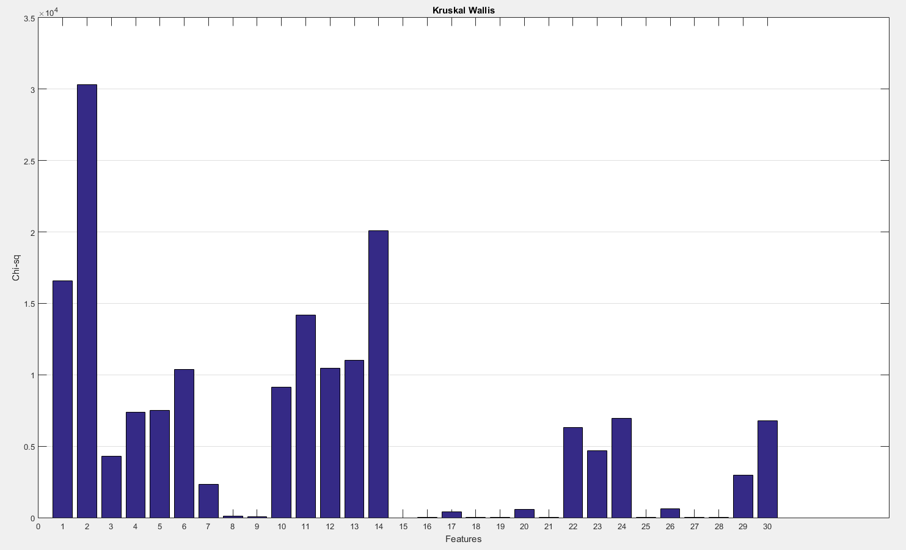
Kruskal-Wallis: ch-squared statistic
Beytula | Ibrahim | Kyazim 2014 / 2015

Slide 14
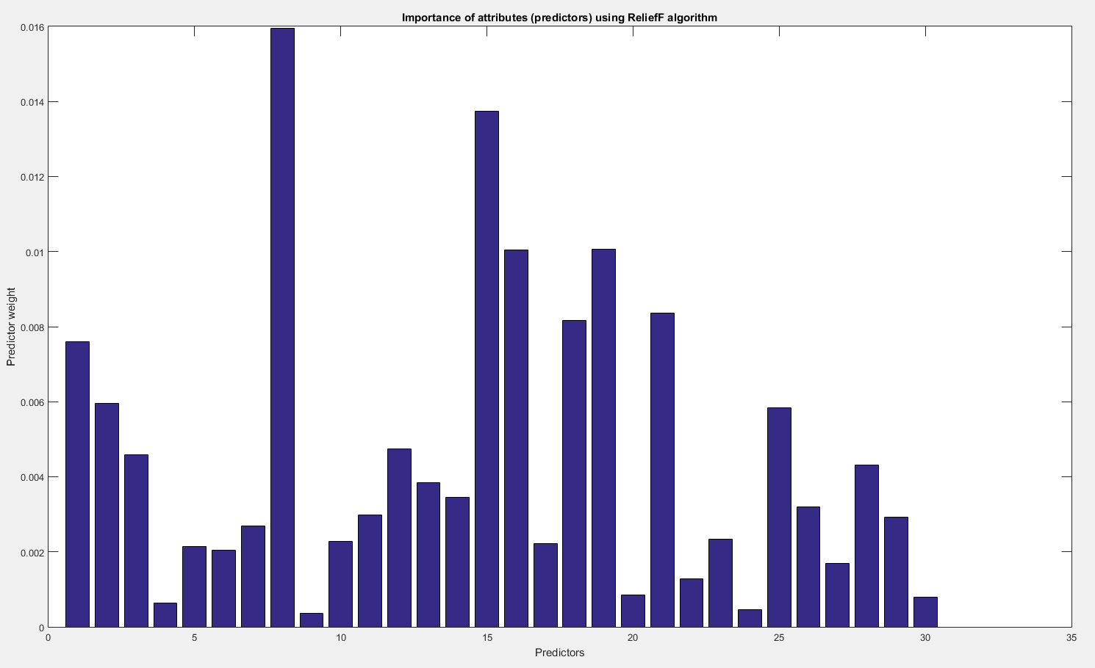
ReliefF algorithm
Beytula | Ibrahim | Kyazim 2014 / 2015

Slide 15
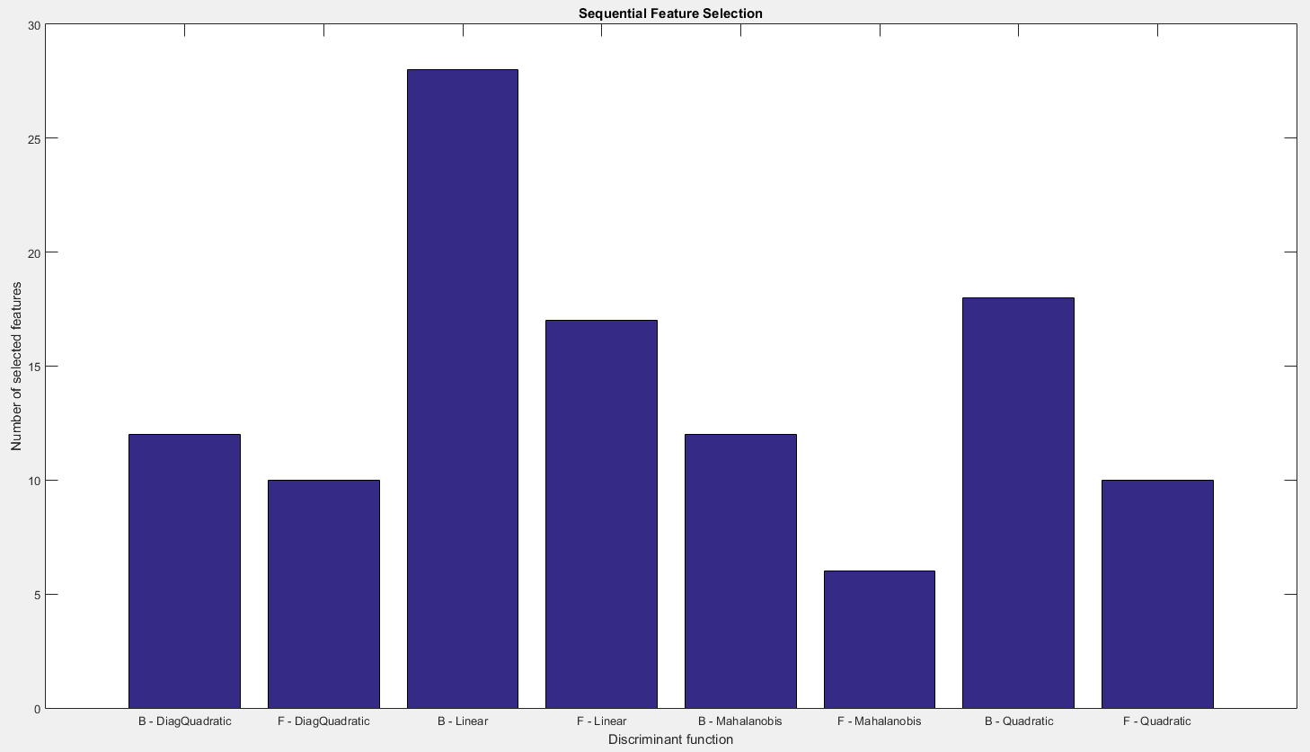
SFS
Beytula | Ibrahim | Kyazim 2014 / 2015

Slide 16
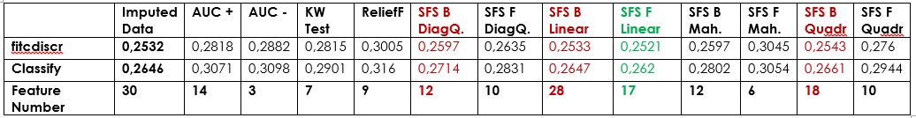
Results
Beytula | Ibrahim | Kyazim 2014 / 2015

Slide 17
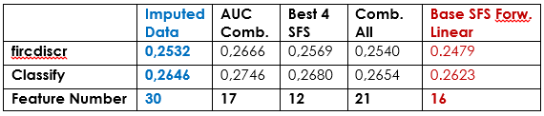
Results
Combining of AUC+ and AUC-
Combining of the best 4 SFS methods
Combining of all the methods
Using the method with the best results (SFS Forward – Linear) as base;
Beytula | Ibrahim | Kyazim 2014 / 2015

Slide 18
Model Choice
Adaptive Boosting (AdaBoostM1) – for binary classification
Random Under Sampling Boosting (RUSBoost)
K-Nearest Neighbors (KNN)
Naïve Bayes
Support Vector Machine (SVM)
Linear Programming Boosting (LPBoost)
TreeBagger
Discriminant: linear, quadratic, diagonal linear, diagonal quadratic, pseudo linear and pseudo quadratic
Beytula | Ibrahim | Kyazim 2014 / 2015

Slide 19
Software
Matlab R2015a
GUI Matlab Interface
Beytula | Ibrahim | Kyazim 2014 / 2015

Slide 20
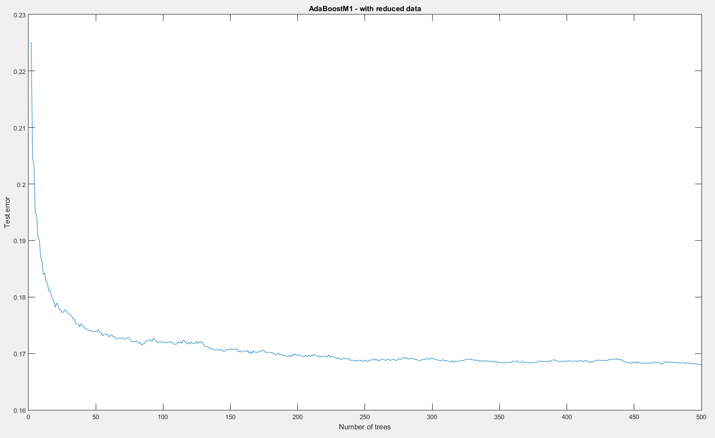
AdaBoostM1 – test error
Beytula | Ibrahim | Kyazim 2014 / 2015

Slide 21
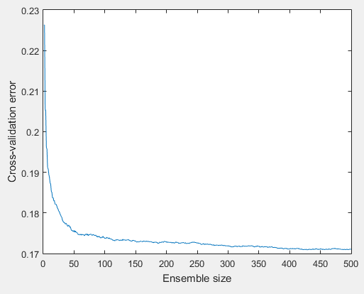
AdaBoostM1 – CV error
Beytula | Ibrahim | Kyazim 2014 / 2015

Slide 22
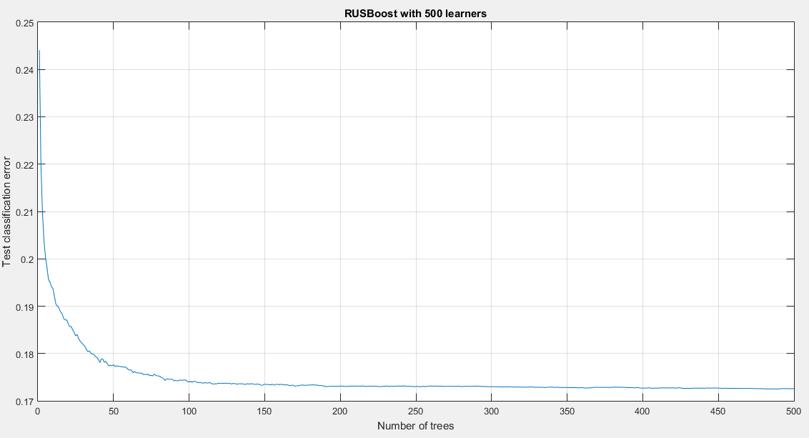
RUSBoost – test error
Beytula | Ibrahim | Kyazim 2014 / 2015

Slide 23
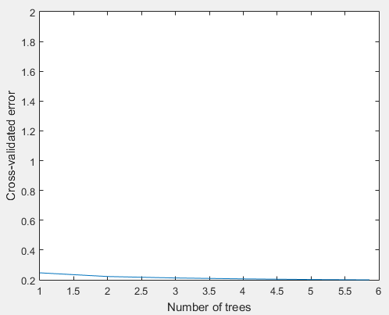
RUSBoost – CV error
Beytula | Ibrahim | Kyazim 2014 / 2015

Slide 24
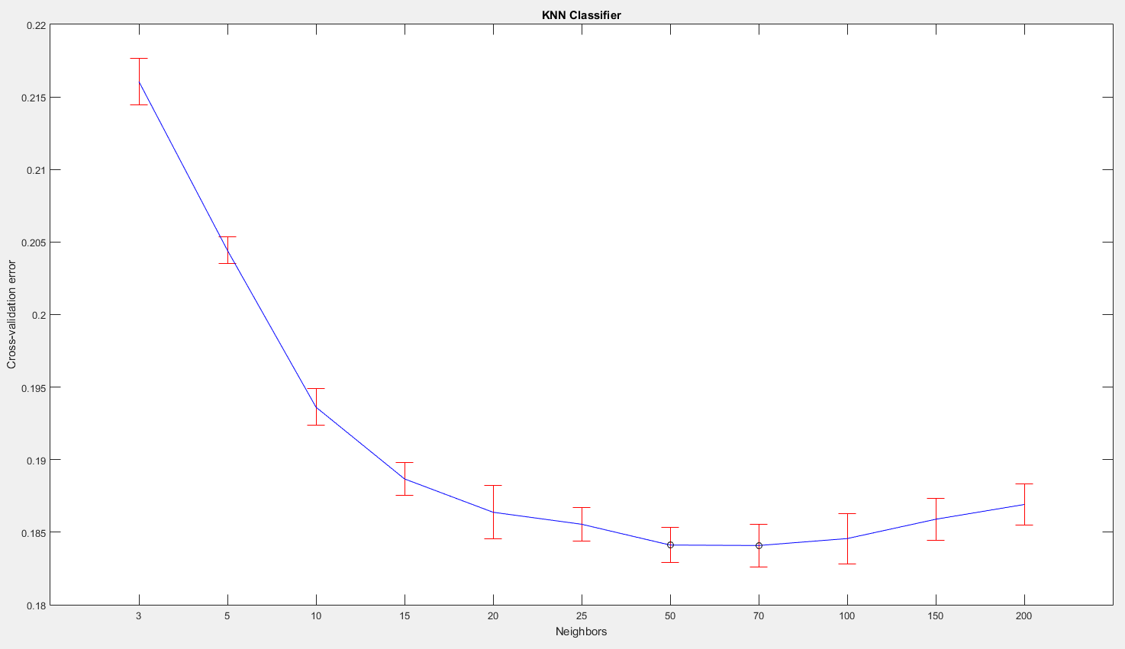
KNN
Beytula | Ibrahim | Kyazim 2014 / 2015

Slide 25
Naïve Bayes
Test error – 26.41 %
Cross-validation error – 26.79 %
Beytula | Ibrahim | Kyazim 2014 / 2015

Slide 26
SVM
Test error – 17.66 %
Cross-validation error – 17.95 %
Beytula | Ibrahim | Kyazim 2014 / 2015

Slide 27
TreeBagger
Test error – 16.30 %
Cross-validation error – 18.09 %
Beytula | Ibrahim | Kyazim 2014 / 2015

Slide 28
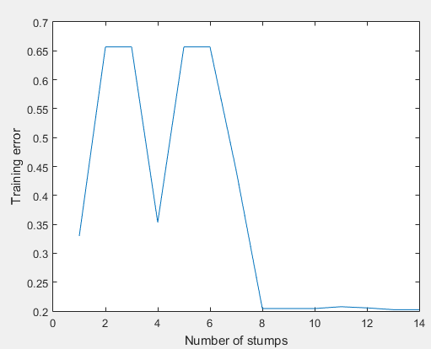
Linear Programming Boosting
Beytula | Ibrahim | Kyazim 2014 / 2015

Slide 29
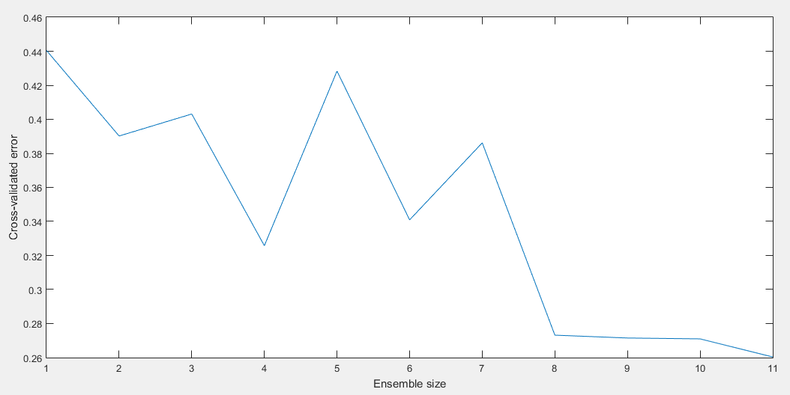
Linear Programming Boosting
Beytula | Ibrahim | Kyazim 2014 / 2015

Slide 30
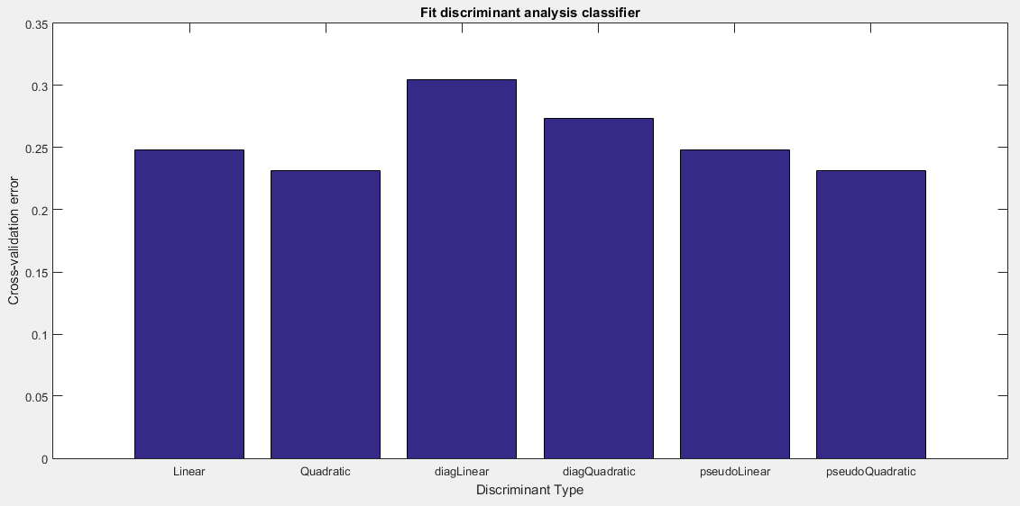
Discriminant
Beytula | Ibrahim | Kyazim 2014 / 2015

Slide 31
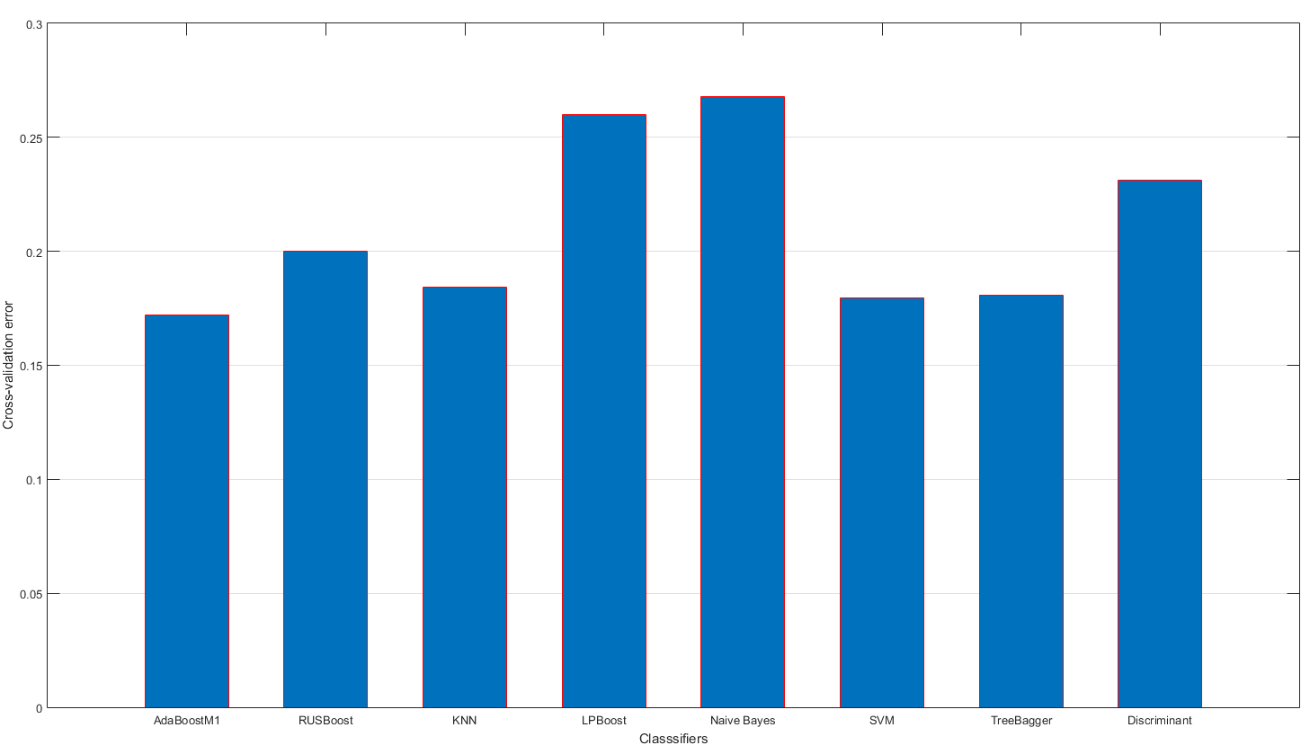
Beytula | Ibrahim | Kyazim 2014 / 2015

Slide 32
Summary
Missing Values – KNN Imputation
Number of Selected Features – 16 (from 30)
Model – Adaptive Boosting (AdaBoostM1)
Beytula | Ibrahim | Kyazim 2014 / 2015

Slide 33
Questions
Beytula | Ibrahim | Kyazim 2014 / 2015

